Slide 1




Capstone Project
DATA VALIDATION USING EXCEL
UPI Transaction Analysis Capstone Project
Tool Used: Microsoft Excel
Purpose: Data Quality Assessment & Relationship Validation
Presented by :
Email Address :
Vishwajeet Kumar Gupta
vishwajeetg399@gmail.com
2026

Slide 2
VALIDATION OBJECTIVES
Verify foreign key relationships across datasets
Identify missing and inconsistent records
Ensure data integrity before analysis
Validate customer_id, merchant_id, upi_id, device_id, and transaction_id references
Prepare clean data for Python, SQL, and Power BI

Slide 3
VALIDATION PROCESS

Slide 4
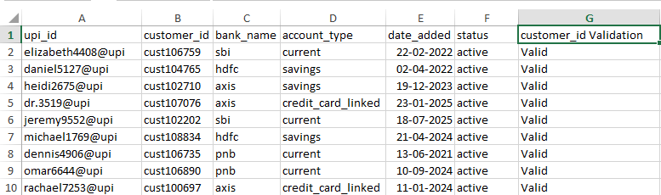
CUSTOMER_ID VALIDATION IN UPI_ACCOUNT_DETAILS
Insights
All customer_id values in upi_account_details were successfully matched with customer_master. No invalid customer records were found, confirming data consistency and referential integrity across datasets.

Slide 5
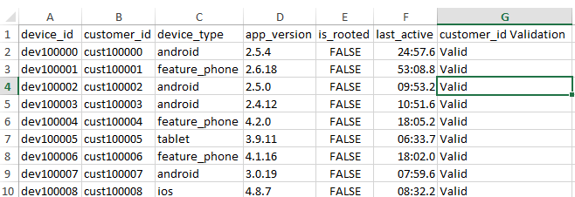
CUSTOMER_ID VALIDATION IN DEVICE_INFO
Insights
All customer_id values in device_info were successfully matched with customer_master. No invalid customer records were found, confirming data integrity and accurate customer-device mapping.

Slide 6
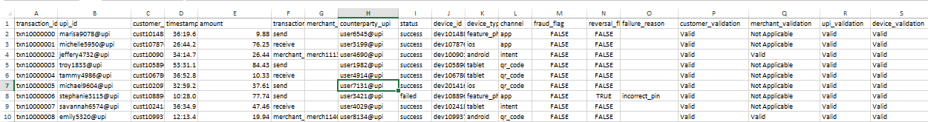
FOREIGN KEY VALIDATION IN TRANSACTION HISTORY
Insights
All key relationships within the transaction history dataset were successfully validated. Customer IDs, Merchant IDs, UPI IDs, and Device IDs matched their respective master tables, confirming strong referential integrity and data consistency across the project database.

Slide 7
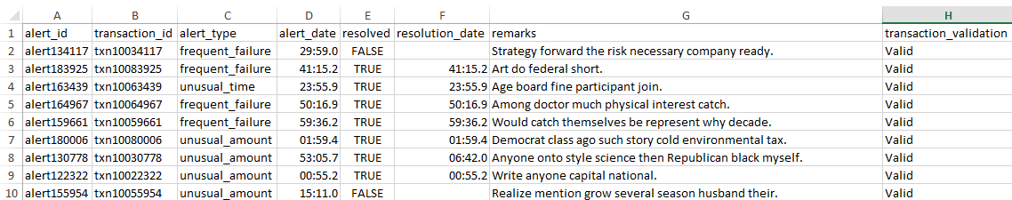
TRANSACTION_ID VALIDATION IN FRAUD_ALERT_HISTORY
Insights
All transaction IDs in fraud_alert_history were successfully matched with transaction history records. No invalid transaction references were found, confirming accurate fraud tracking and data consistency.

Slide 8
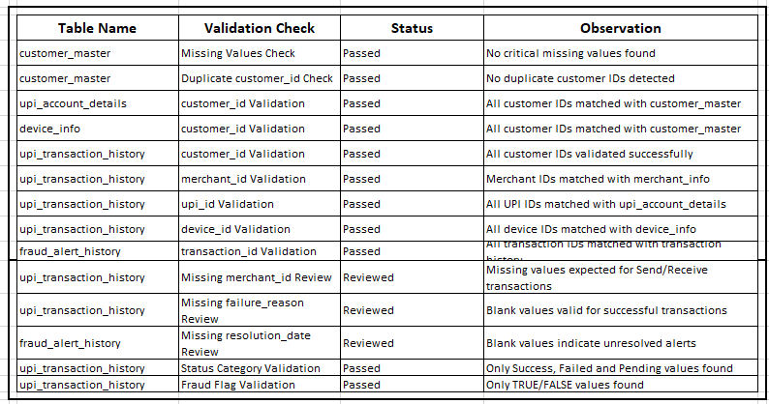
VALIDATION SUMMARY
Insights
All critical data validation checks were successfully completed. Foreign key relationships were verified across all datasets, no major data quality issues were identified, and the dataset was confirmed to be clean, consistent, and analysis-ready.

Slide 9
KEY OBSERVATIONS
No critical data quality issues found
Missing merchant_id expected in P2P transactions
Missing failure_reason valid for successful transactions
Missing resolution_date indicates unresolved alerts

Slide 10
CONCLUSION
All major foreign key relationships validated successfully
Dataset consistency verified across all tables
No critical errors detected
Data approved for Python, SQL, and Power BI analysis|
The dataset was found to be reliable, consistent, and ready for advanced analytics and dashboard development.

Slide 11

Capstone Project
THANK YOU
for your time and attention
Prepared By:
Vishwajeet Kumar Gupta

